Slide 1
IOT based Smart Shopping Cart Using RFID and NodeMCU
By,
Snephia Sevi
S4 MCA 2020 B batch

Slide 2
Relevance of topic
We all have waited in a queue for payment in shopping malls and other places, its very tiring and wastes a lot of time in the billing process.
At billing counter customer may face problems like waiting and don’t know even they have sufficient money for the products they purchase.
So it is relevant to build a smart shopping cart with an inbuild RFID reader module ,NodeMCU and lcd display that not only reduces the waiting time but also makes the process very smooth and easy.

Slide 3
Description of project
we use RFID cards and RFID readers with NodeMCU to build the Smart Shopping Cart project. The cart information and total value will be displayed on the webpage as well as on LCD. Each RFID card is associated with a certain product and an RFID reader is installed in the cart, which reads the product details like Price and Product details and sends them to NodeMCU ESP8266. Then NodeMCU process the available items and total value in the cart and send them to ESP8266 Webserver, which can be monitored on a web browser.

Slide 4
Objectives
To bulid a smart shopping cart which helps for shopping according to our budget.
To build a Shopping cart with inbuild RFID reader module and lcd display.
To create a web page for displaying total bill details of shopping.

Slide 5
Existing System
Customer enters into a shopping mall , collect items in the normal cart .
At the billing counter , by standing in queue , take each item one by one scanned using barcode reader and bill is generated.
There may be more number of counters , but there will be one person in the counter for doing all the billing process.It takes lot of our time.

Slide 6
Proposed System
A smart shopping cart with an inbuild RFID reader module,NodeMCU and an lcd display.
we use RFID cards and Each RFID card is associated with a certain product .The cart information and total value will be displayed on the webpage as well as on LCD.

Slide 7
modules identified
RFID reader module
lcd display module
web page view module

Slide 8
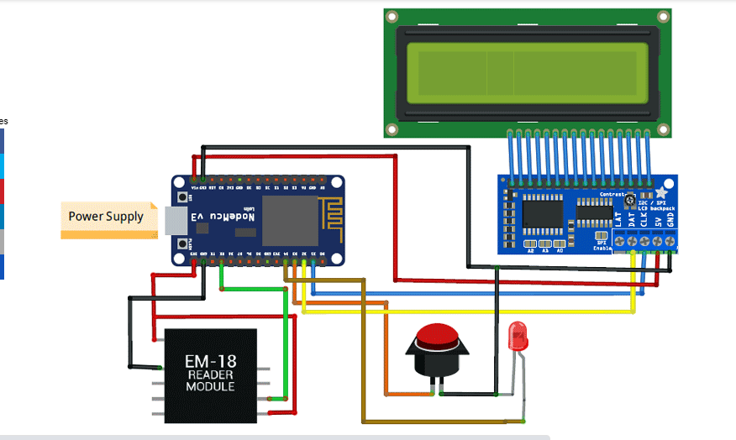
Circuit Diagram

Slide 9
Electronic components required
ESP8266 NodeMCU -1
16*2 Alphanumeric LCD-1
I2C module for 16*2 LCD-1
4 pin Tactile switch-1
EM18 RFID Reader-1
RFID tags

Slide 10
Screenshots

Slide 11
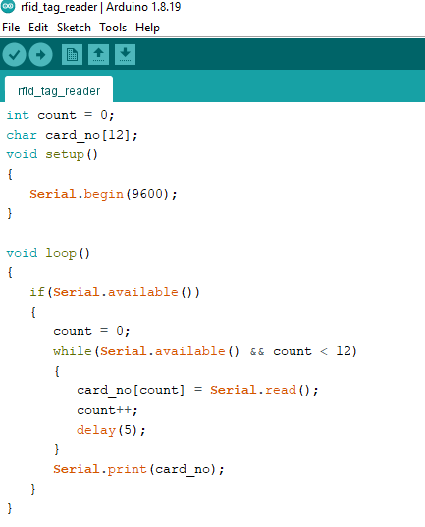
To identify RFID Tag , read it’s unique code

Slide 12
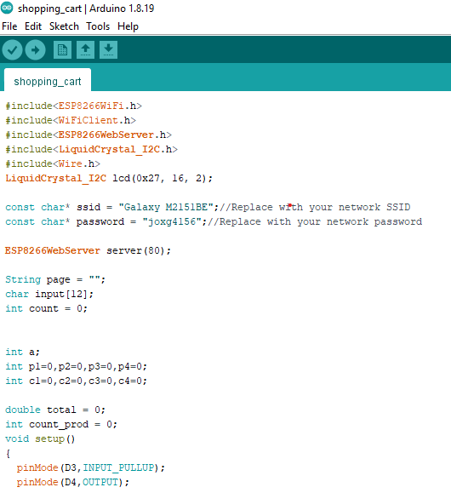

Slide 13
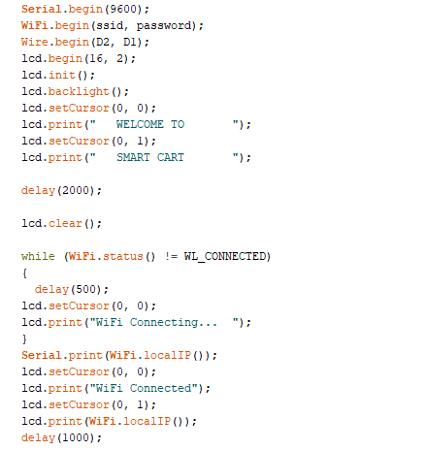

Slide 14
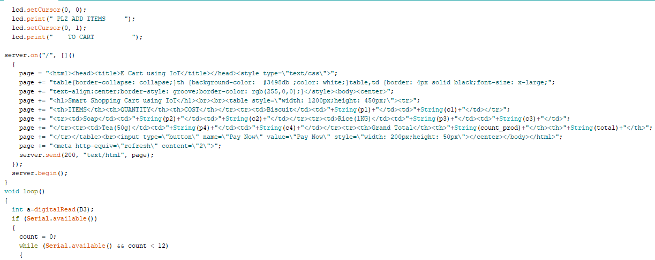

Slide 15
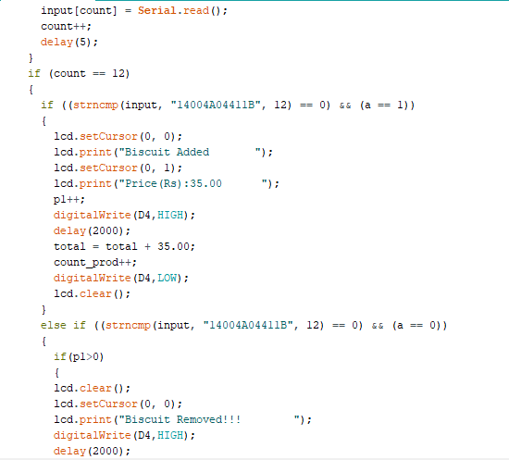

Slide 16
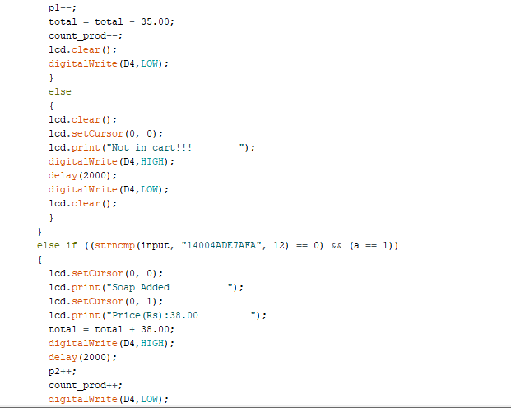

Slide 17
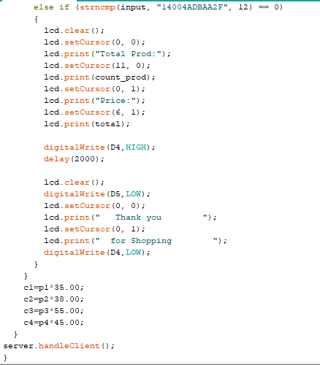

Slide 18
OUTPUT

Slide 19
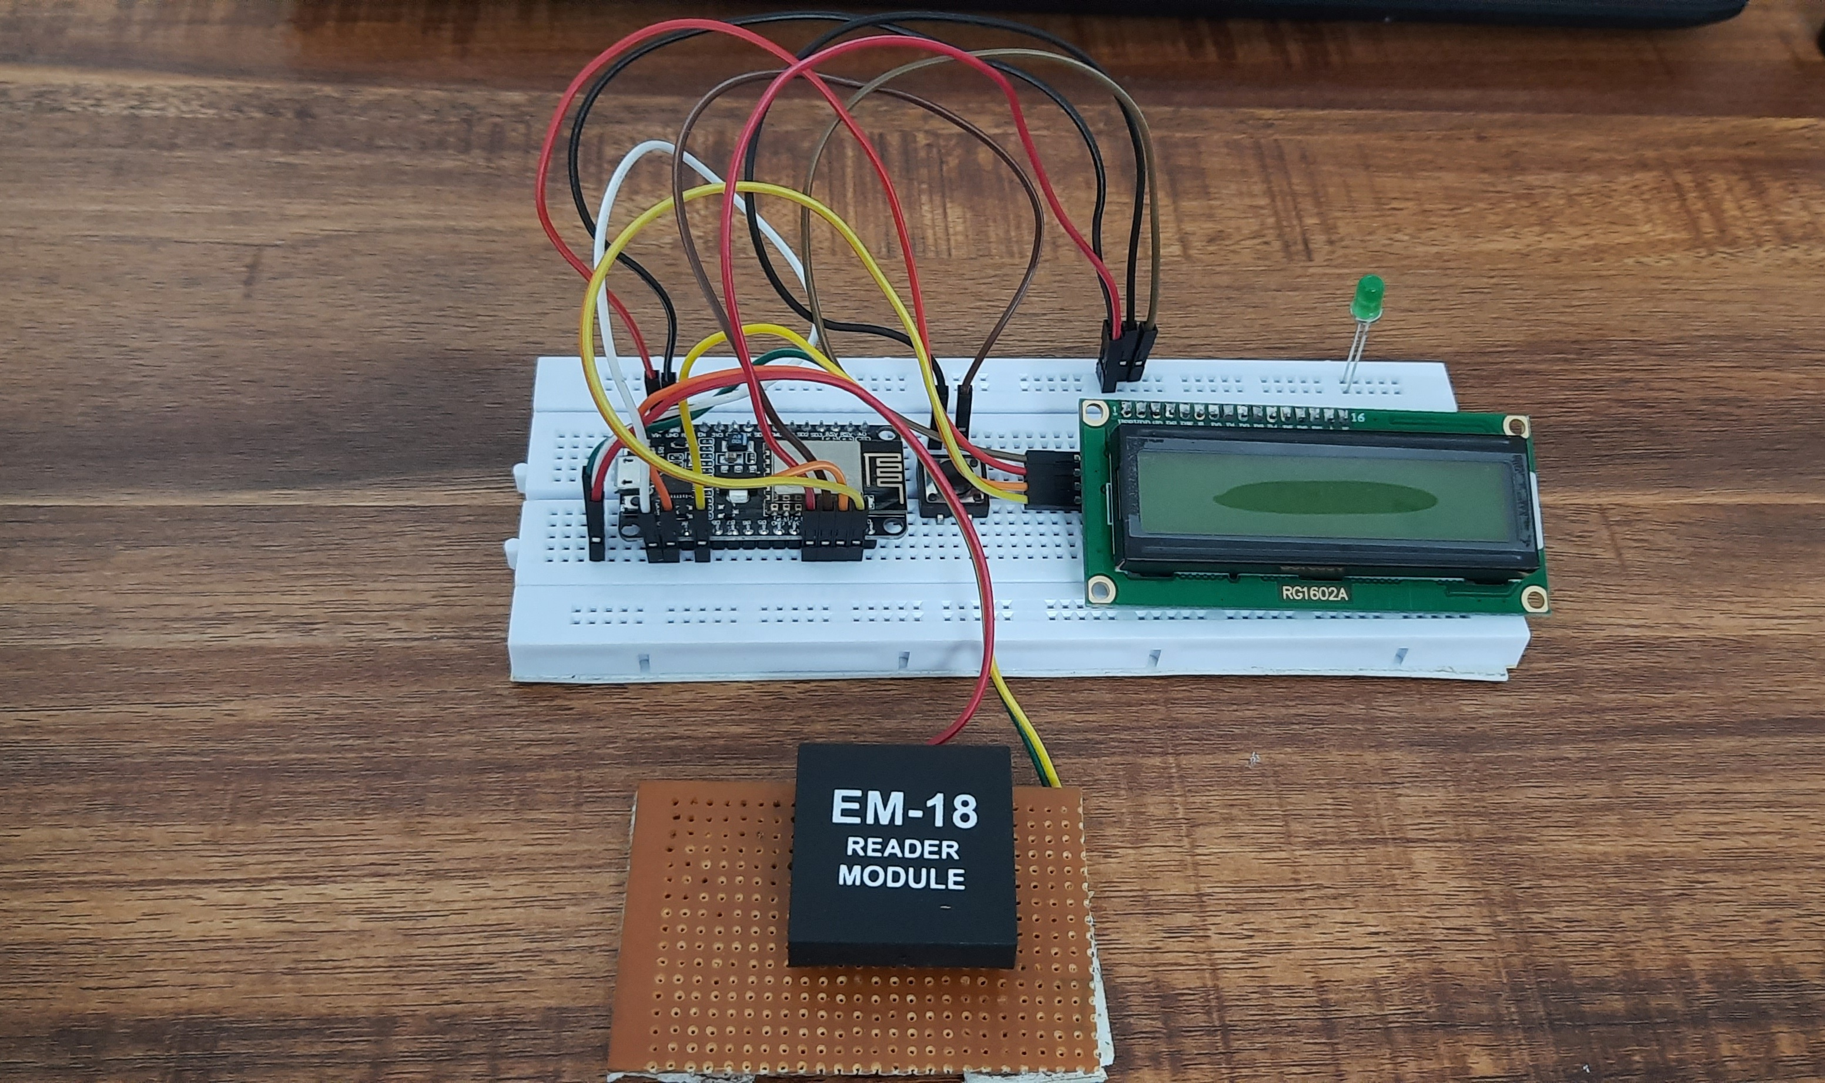

Slide 20
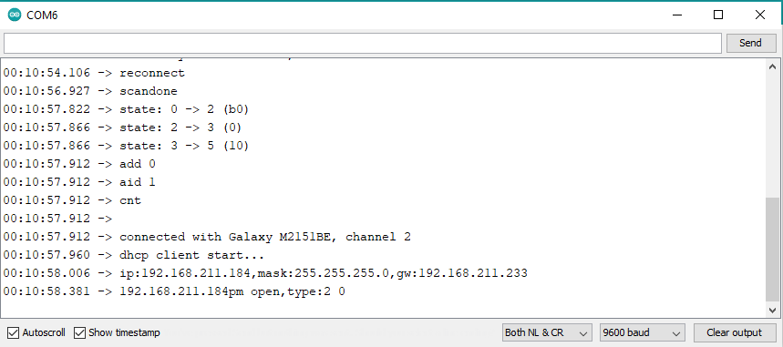

Slide 21
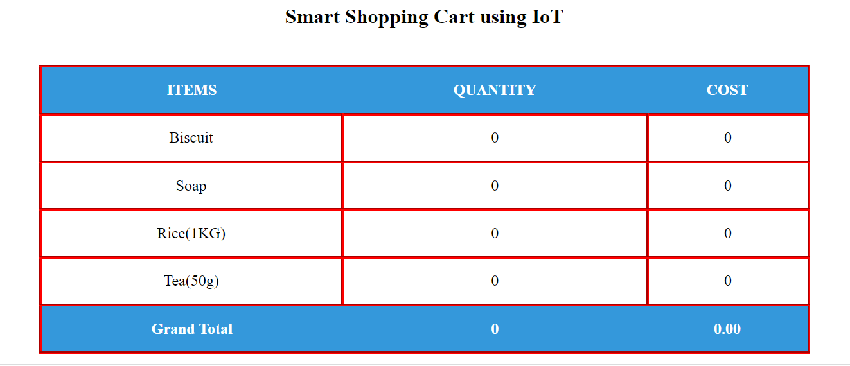

Slide 22
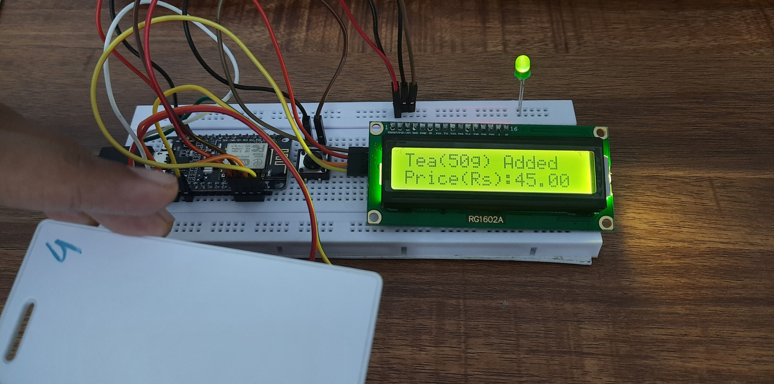

Slide 23
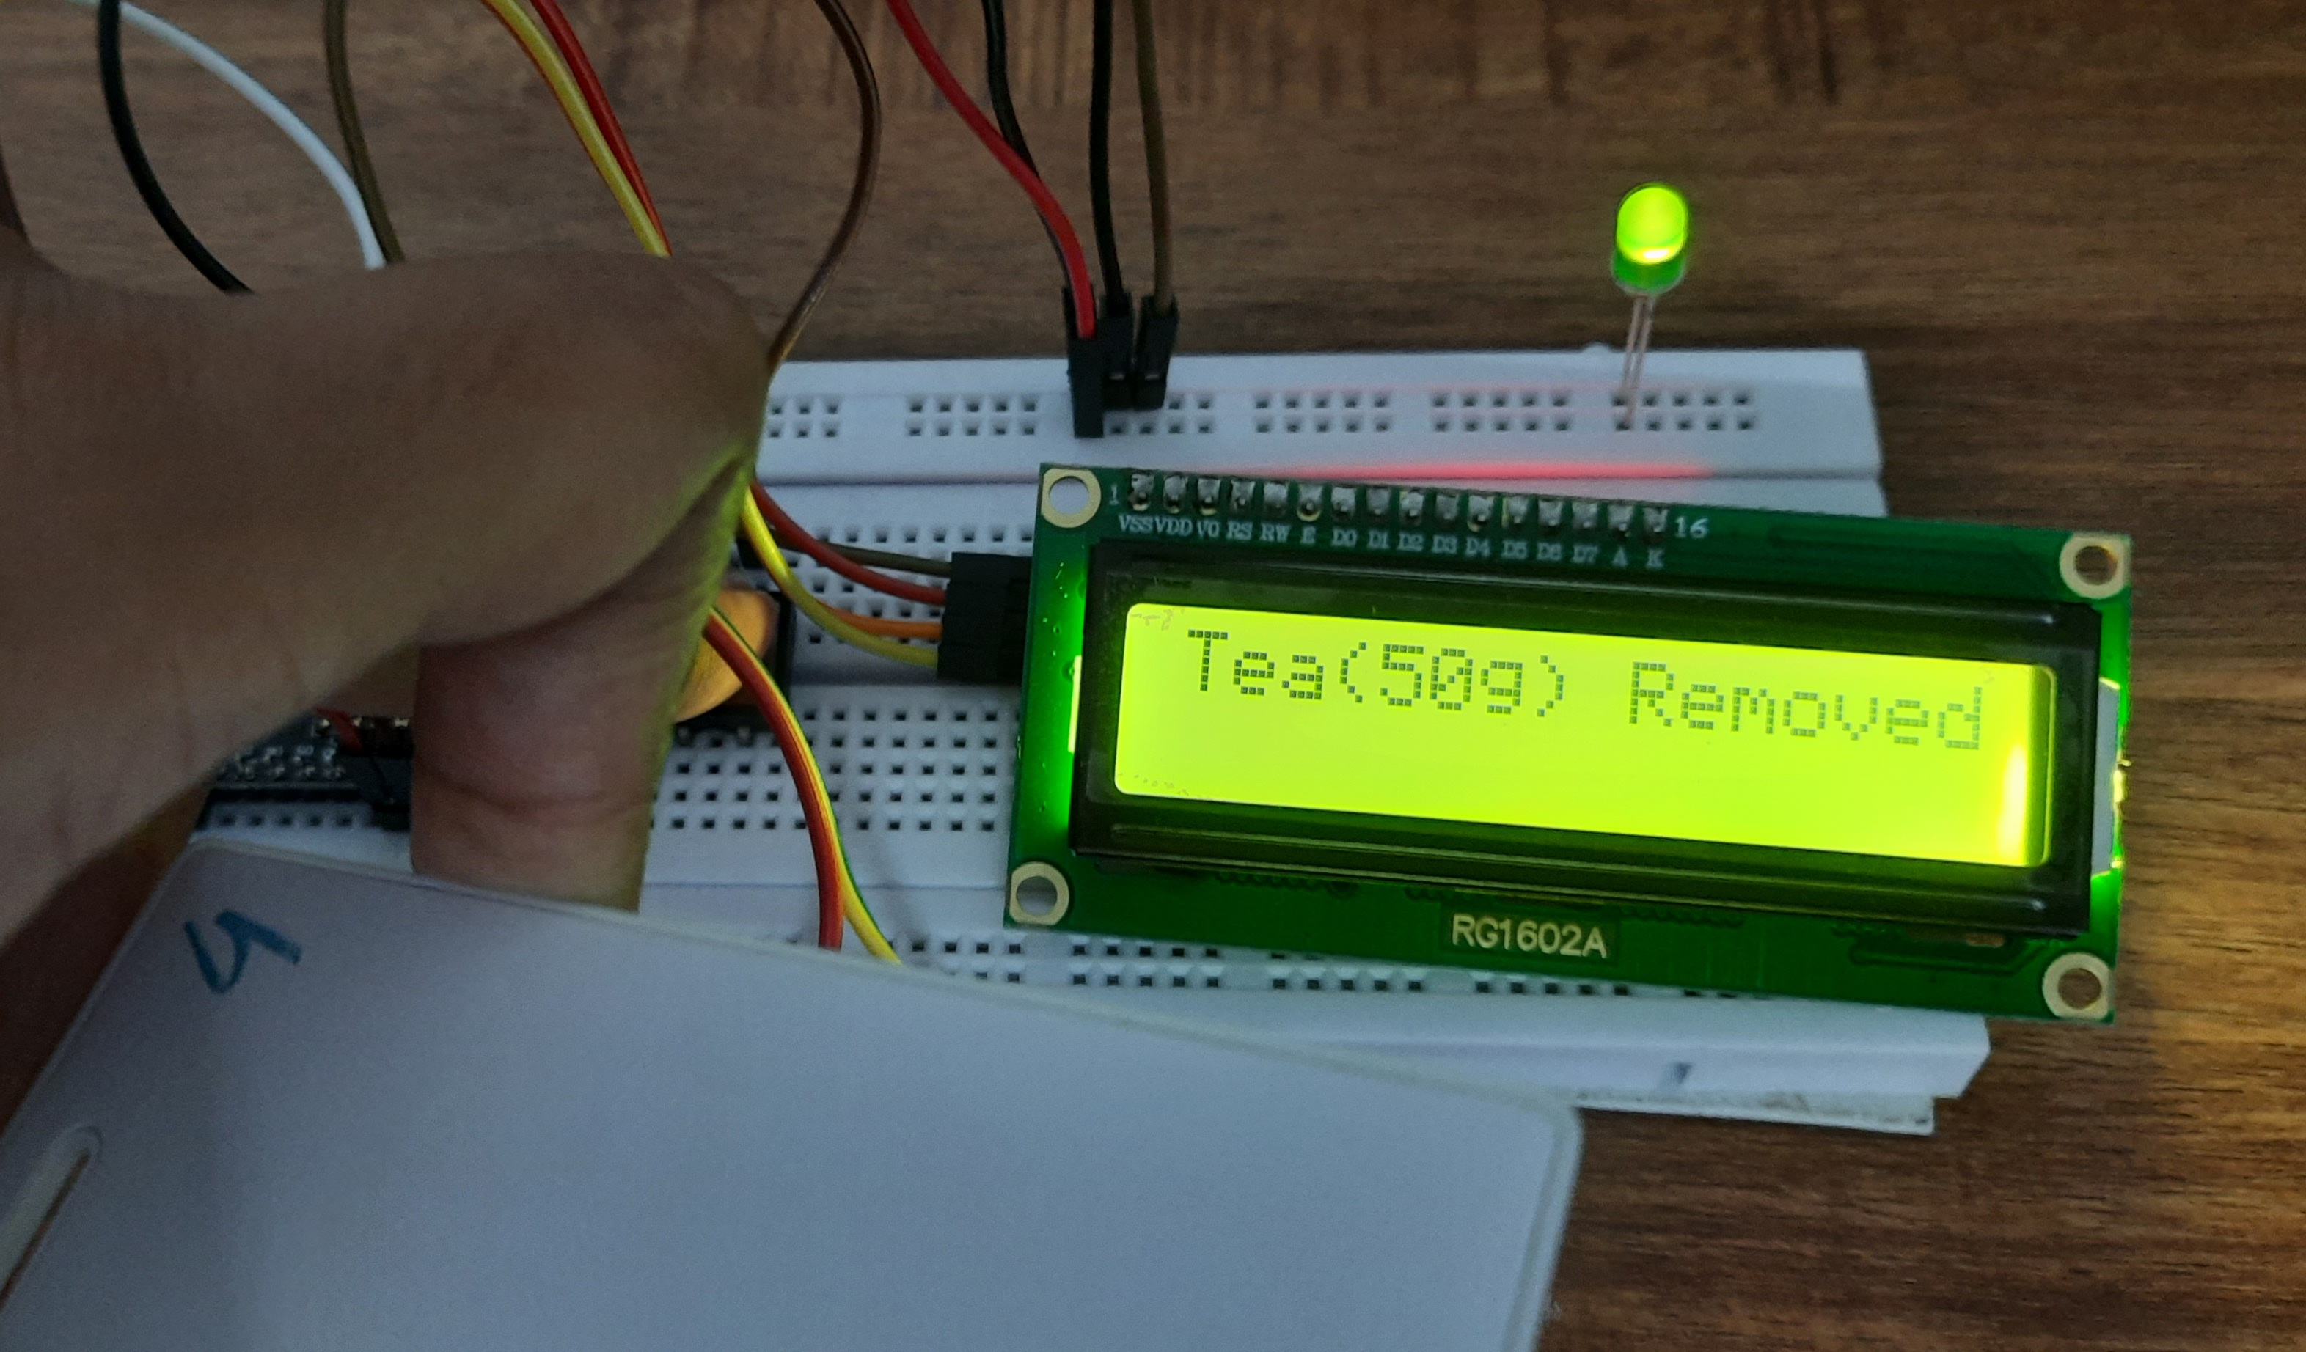

Slide 24
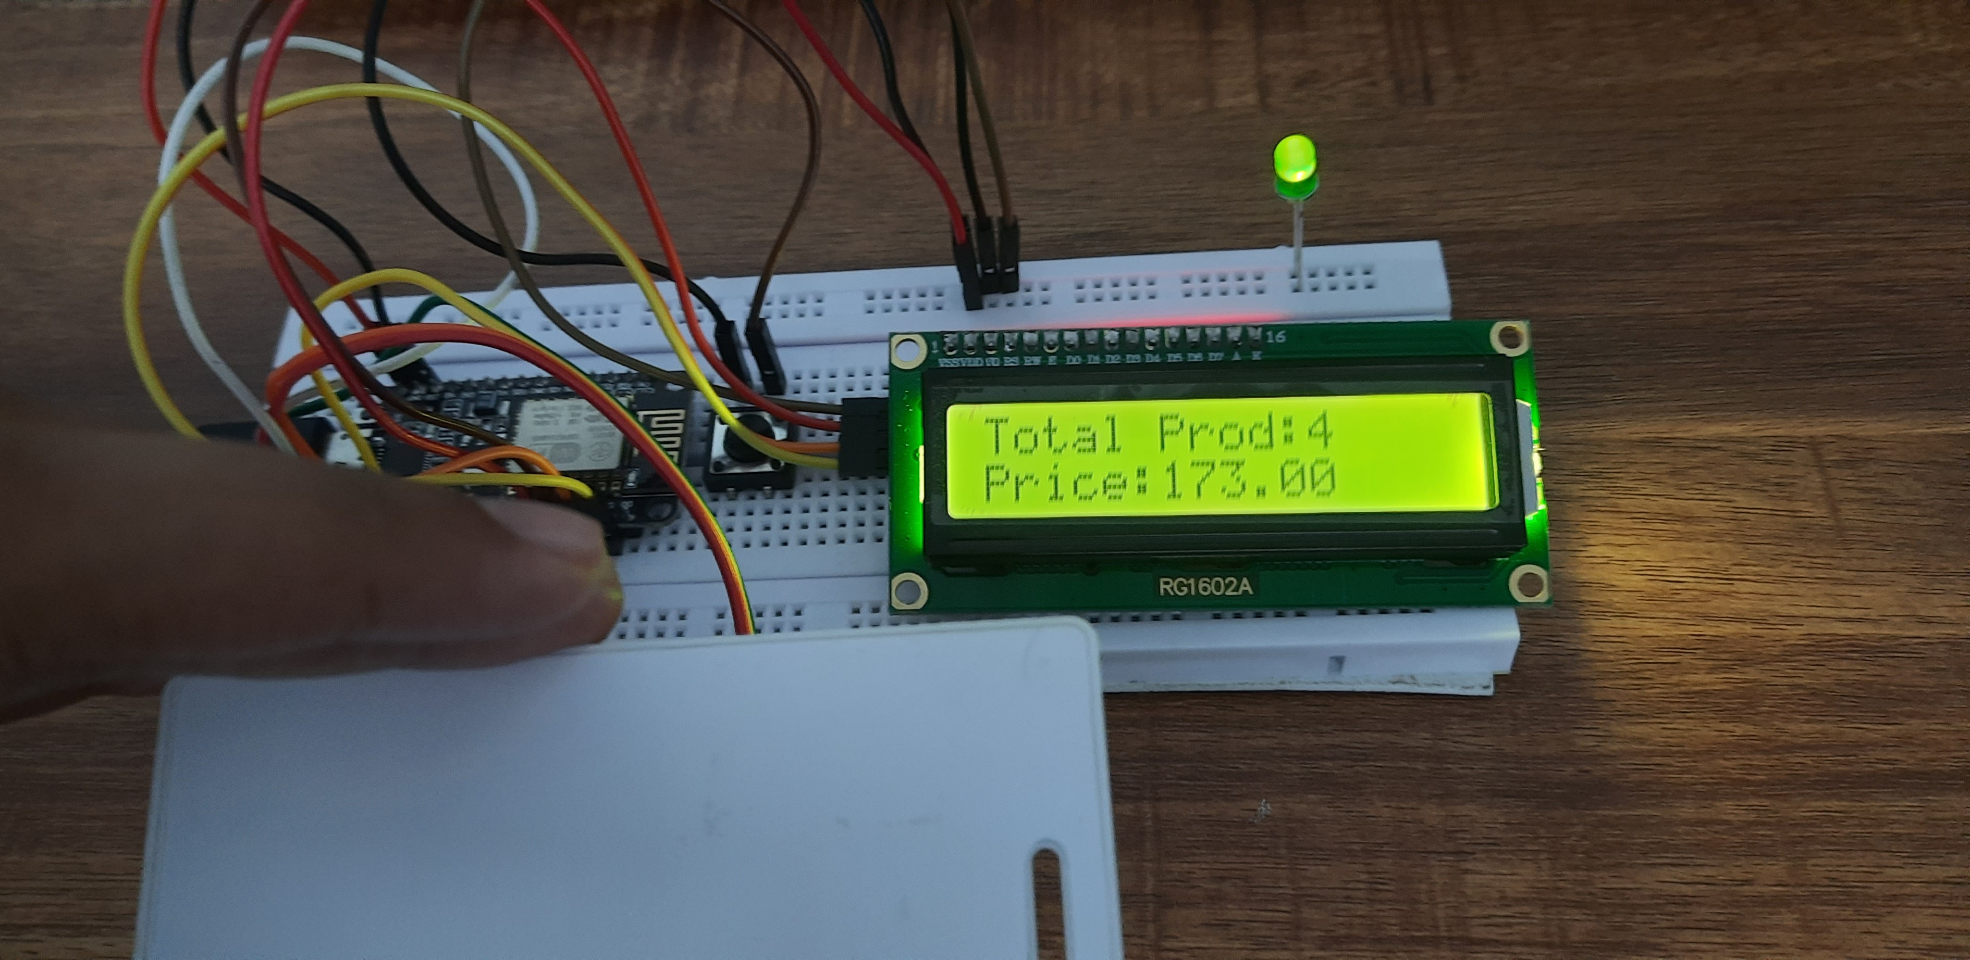

Slide 25
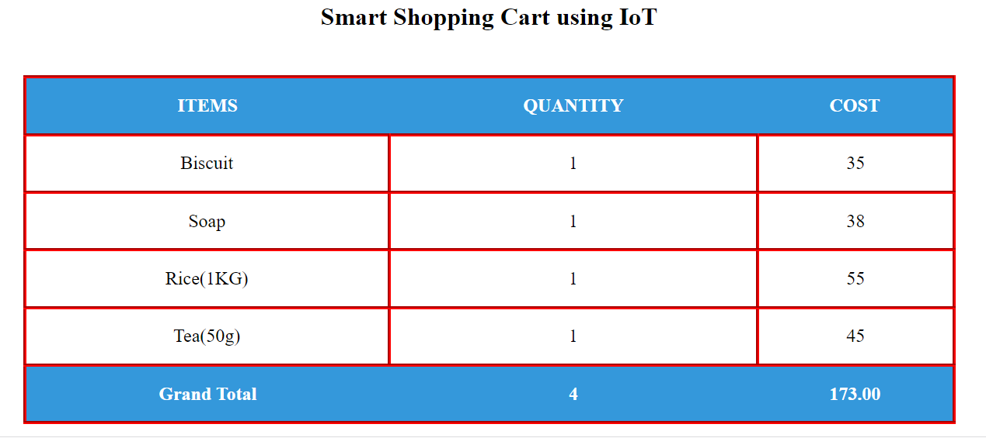

Slide 26
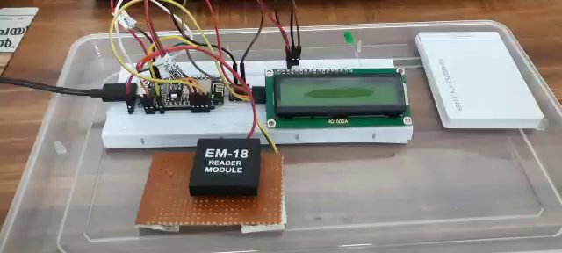
Demonstration

Slide 27
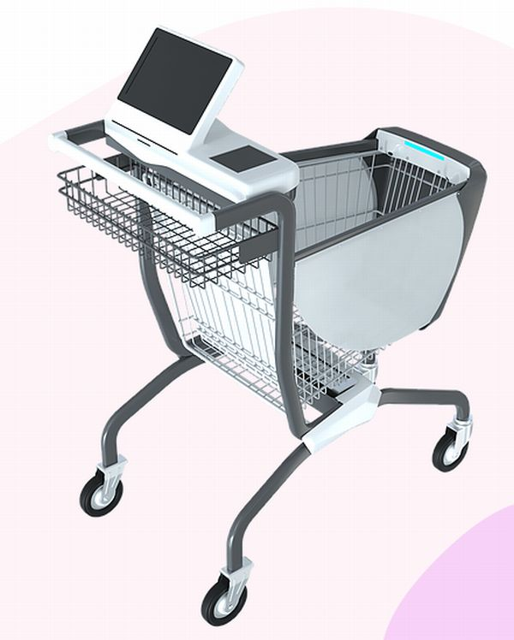

Slide 28
Conclusion
As the Technology is developing rapidly day by day and the time is very precious to everyone there is a need to bring significant changes in the shopping procedure which is efficient and time saving. This project “IoT based Smart Shopping Cart Using RFID and NodeMCU ”, brings a customer friendly cart where billing technique is improved. It is less time consuming as compared to regular billing technique. It is more reliable and provides ease for shopping. Here I conclude that the proposed system is time saving i.e. faster check out process and also generates more revenue to the shopping mall as more number of customers check out in less time.This system Reduces require number of salesman at the counter.

Slide 29
Thankyou

